Slide 1
Leveraging RAFT for Accessible Mental Well-Being Support
Irine Juliet
September 20 2024

Slide 2
Objective
This project aims to explore the use of Retrieval-Augmented Fine-Tuning (RAFT) to develop a mental well-being support chatbot focused on stress management, emotional intelligence, and social skills—key areas where many young people face challenges.

Slide 3
01
Problem Statement

Slide 4
The core problem(s)
Growing Mental Health Crisis:
Over 1 billion people globally face mental health problems, with with young people particularly affected. Limited resources in low-resource communities unable to meet growing demand.
Barriers to Access:
Access to mental health services is hindered by long wait times, geographical barriers, cost, and social stigma, leaving many without timely support.
The Rise Of LLM-Powered Solutions:
Individuals increasingly rely on generic AI chatbots like ChatGPT for well-being support, but these tools often lack domain-specific nuance and personalization, and may not provide contextually accurate responses, limiting their effectiveness in real-time emotional support.

Slide 5
02
Existing
Solutions

Slide 6
Improving contextual support
Domain-Specific Fine-Tuning
Retrieval Augmented Generation (RAG)
Approach: Adapts base models to domain-specific datasets for more relevant and context-aware responses.
Challenges: Potential for oversimplification and hallucination of inaccurate information due to limited training data.
Approach: Enhances responses by integrating external documents for contextual relevance.
Challenges: Risk of introducing irrelevant information due to reliance on semantic proximity for document retrieval.

Slide 7
Improved Personalization: Both DSF and RAG have advanced mental health support chatbots by delivering more tailored and contextually relevant support, improving on generic chatbots.
Ongoing Challenges: Despite advancements, ensuring information accuracy and relevance remains challenging, highlighting the need for continuous refinement of approaches. The sensitive nature of mental support necessitates an approach that combines specialized knowledge, contextual understanding, and precise information retrieval, while minimizing misinformation.
Insights

Slide 8
03
Opportunity For RAFT

Slide 9
What is RAFT?
RAFT (Retrieval Augmented Fine-Tuning) stands between RAG and DSF.
Trains the model to understand and adapt to the domain before being used in a RAG setup.
To build the fine tuning dataset:
RAFT will take carefully selected docs as input.
Chunk them into sections.
Query GPT-3.5/GPT-4 to synthetically generate question-answer pairs from these chunks, provide CoT explanation and add distractor chunks to each pair. This helps the model learn to distinguish between useful and irrelevant information when forming answers.

Slide 10
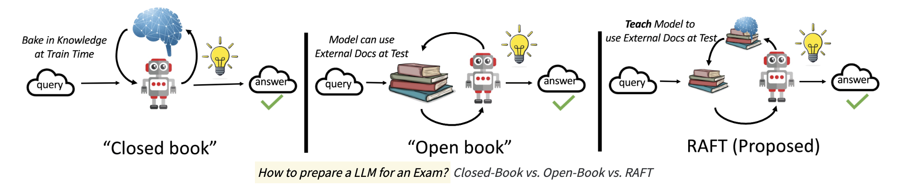
Analogy

Slide 11
Putting it all together
Document Selection
3. Fine-tuning
Fine-tune the LlamA-2-7b model using the generated dataset
Carefully select psychotherapy literature and documents aligned with the objective
2. Dataset
4. Chatbot
Create the dataset using the RAFT algorithm
Integrate the fine-tuned model with a basic chatbot interface

Slide 12
Key Deliverables
Project Proposal (Sept 12)
Prepared Dataset from RAFT
Fine-tuned LLM
Basic Chatbot Interface with fine-tuned Model
Performance Report
Final Project Report
Working Prototype of the Mental Well-being Support Chatbot

Slide 13
References
World Health Organization. (2022). World mental health report: Transforming mental health for all. Geneva: World Health Organization. https://www.who.int/publications/i/item/9789240049338
Song, I., et al. (2024). The Typing Cure: Experiences with Large Language Model Chatbots for Mental Health Support
Lewis, P., et al. (2020). Retrieval-Augmented Generation for Knowledge-Intensive NLP Tasks.
Zhang, T., et al. (2024). RAFT: Adapting Language Model to Domain Specific RAG. arXiv preprint arXiv:2403.10131v2.

